Slide 1
Model performance and PCA of Workload variables

Slide 2
Mental workload
Hospitalist mental workload
Group | Model | Accuracy (95% CI)
3-class (1)/(2,3,4,5,6)/(7) | Multinomial Logistic | 0.88 (0.86, 0.88)
 | Random Forest | 0.87 (0.86, 0.89)
 | SVM | 0.88 (0.86, 0.90)
 | XGBoost | 0.87 (0.85, 0.88)
 | KNN | 0.86 (0.81, 0.87)

Slide 3
Hospitalist Effort
Hospitalist Effort
Group | Model | Accuracy (95% CI)
3-class (1)/(2,3,4,5,6)/(7) | Multinomial Logistic | 0.90 (0.88, 0.91)
 | Random Forest | 0.90 (0.89, 0.91)
 | SVM | 0.89 (0.86, 0.90)
 | XGBoost | 0.87 (0.86, 0.89)
 | KNN

Slide 4
Physical workload
Hospitalist physical workload
Group | Model | Accuracy (95% CI)
3-class (1,2,3,4,5)/(6)/(7) | Multinomial Logistic | 0.96 (0.95, 0.97)
 | Random Forest | 0.97 (0.96, 0.97)
 | SVM | 0.96 (0.95, 0.98)
 | XGBoost | 0.96 (0.95, 0.97)
 | KNN | 0.97 (0.96, 0.98)

Slide 5
Temporal workload
Hospitalist temporal workload
Group | Model | Accuracy (95% CI)
3-class (1,2,3,4,5)/(6)/(7) | Multinomial Logistic | 0.97 (0.95, 0.97)
 | Random Forest | 0.98 (0.96, 0.98)
 | SVM | 0.97 (0.95, 0.98)
 | XGBoost | 0.97 (0.95, 0.97)
 | KNN | 0.97 (0.96, 0.98)

Slide 6
Frustration
Hospitalist frustration
Group | Model | Accuracy (95% CI)
3-class (1,2,3,4,5)/(6)/(7) | Multinomial Logistic | 0.96 (0.95, 0.97)
 | Random Forest | 0.96 (0.95, 0.97)
 | SVM | 0.97 (0.95, 0.97)
 | XGBoost | 0.96 (0.95, 0.97)
 | KNN

Slide 7
Hospitalist performance
Hospitalist performance
Group | Model | Accuracy (95% CI)
3-class (1,2,3,4,5)/(6)/(7) | Multinomial Logistic | 0.94 (0.93, 0.95)
 | Random Forest | 0.94 (0.93, 0.95)
 | SVM | 0.94 (0.93, 0.96)
 | XGBoost | 0.94 (0.92, 0.95)
 | KNN | 0.94 (0.90. 0.97)

Slide 8
Why use PCA?
Multiple workload measures are overlapping and redundant
PCA reduces them into fewer, clearer factors
First 3 PCAs explain ~81% of differences in workload
Helps focus on the big picture patterns, not scattered details
“PCA is similar as doing a differential diagnosis: instead of treating each symptom separately, we look for the underlying syndrome. PCA finds those syndromes in the workload data — the common factors that explain most of the symptoms.”

Slide 9
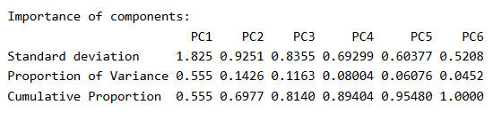
PCA Results Summary
Principal Components (PCs):
PC1 explains 55.5% of the variance
PC2 adds 14.3% (cumulative 69.8%)
PC3 adds 11.6% (cumulative 81.4%)

Slide 10
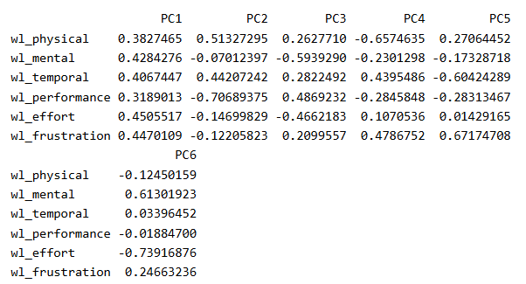
PCA Loadings (Top Contributors)
Interpretation:
Workload dimensions cluster into 3 main components
PC1 → General workload intensity
PC2 → Performance vs. physical demand trade-off
PC3 → Mental demand vs. performance load

Slide 11
